Slide 1
Navigating the mid-career plateau
Uma Chingunde
@umanagineer

Slide 2
Hi! I’m Uma.
Stripe, Delphix, VMware
Engineering Manager for 5 years
Engineer for 10 before
Support engineers and managers
Very much in this phase of my career :)
Notes:
Background on myself and my personal story in getting here.

Slide 3
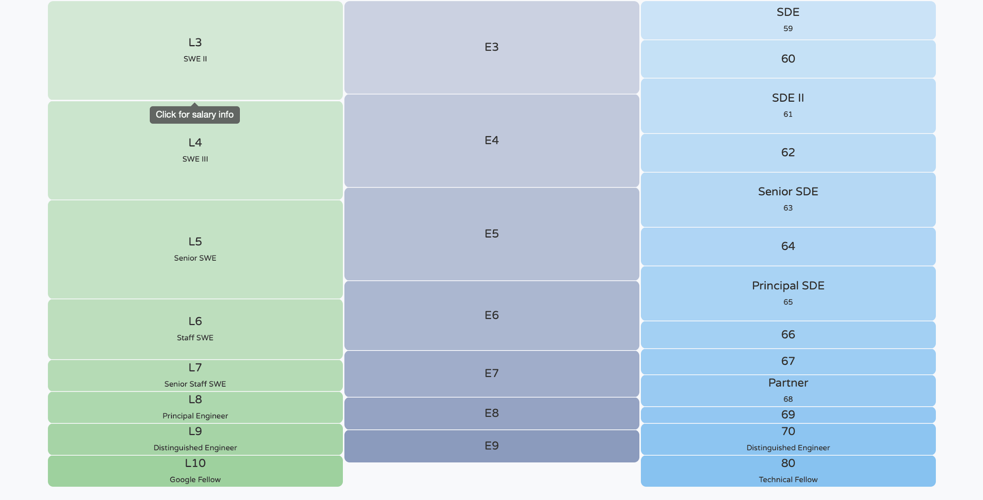
Career ladders and levels?
*From levels.fyi
Notes:
Many career ladders have career levels where future levels are optional. Essentially people can stay on that level forever if they choose.

Slide 4
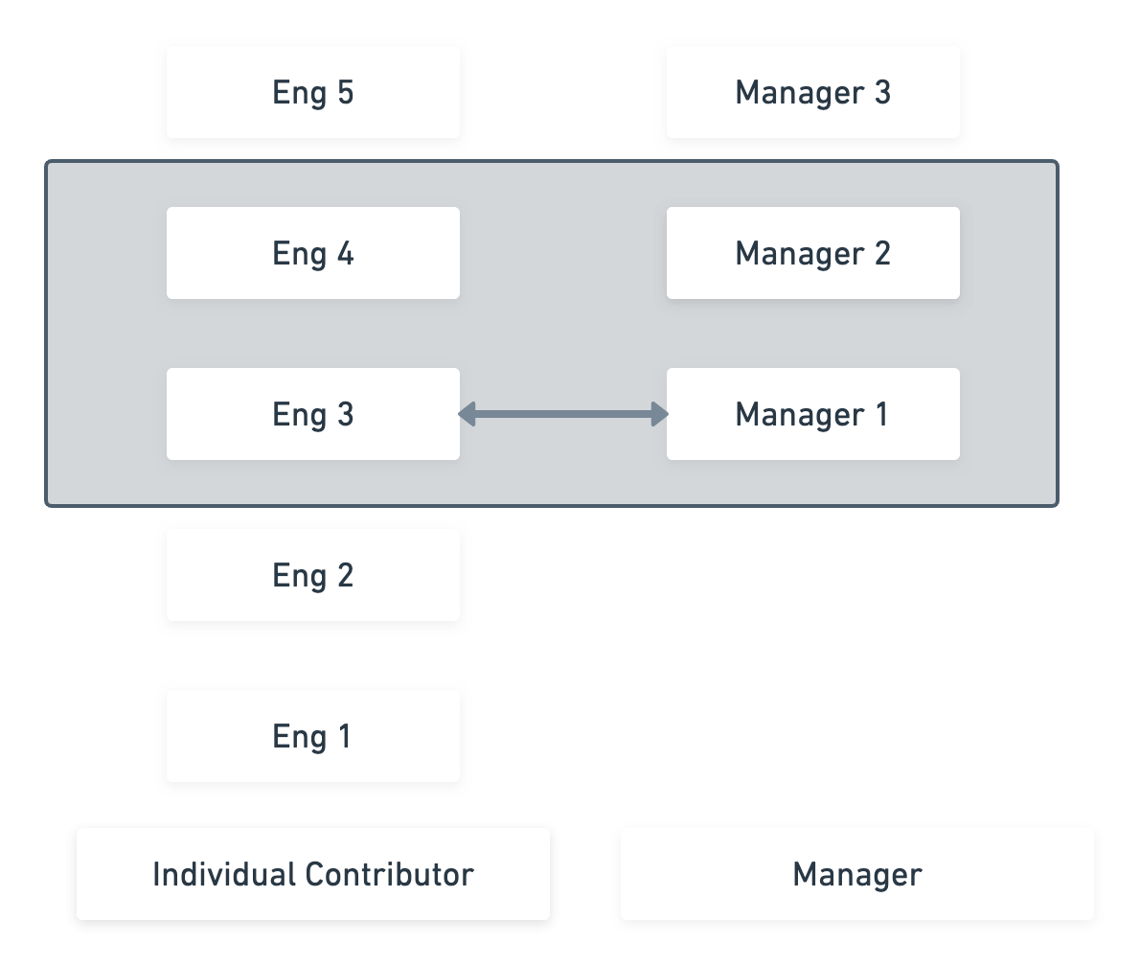
And the Plateau ...

Slide 5
“If you don’t know where you are going, any road will take you there” - Lewis Carroll (paraphrased)

Slide 6
Not a ladder

Slide 7
Nor a jungle gym

Slide 8
Notes:
First this is not a “bad” thing. This recognizes an increase in breadth of responsibilities and options through progression and increased complexity at higher levels.
However many of us, as well as the people we support as managers can understandably find this stage to be challenging, if not mildly panic inducing to navigate.
As always you are in charge of your career and only you.
Embrace the opportunity and the challenge

Slide 9
Strategies
Core skills
Opportunities and impact over roles
Career design patterns
Underrepresented in tech
Evaluating organizational support
Career plan

Slide 10
Core skills
Strong overlap in skills for all senior roles
Ensure you are always focusing on learning these
Notes:
Recognize the strong overlap in the skills required for all senior roles. Thinking of these as skills to acquire regardless of which speciality you pick IC/manager makes it far less of a fraught decision to “pick a side” or focus on some skills over others.

Slide 11
Communication
Notes:
Communication: The ability to communicate your ideas to diverse audiences via different mediums is essential at all stages in your career. But it becomes particularly important as you become more senior because your ability to communicate your ideas will be a key to their success.
Your ideas are only as good as your ability to communicate them
Written
Verbal
Different mediums
Different audiences
Examples - as an IC, as an EM, as PM etc .

Slide 12
Empathy
The corollary to communication
Empathy
For your teammates
Users of your products
Notes:
Empathy both for the users of your work and your fellow team members, is key to solving the “right” problems. Having the ability to see things from different perspectives and solving for those vs for the obvious narrow initial subset helps with engineering and non engineering problems.
How do you develop empathy? - practice
Just keep doing it over and over again

Slide 13
Mentoring and coaching
Notes:
This really builds on both of the previous skills.
And this can be the hardest to think about. Because we all think about it differently.
But everyone can do this differently.
Example.
Senior IC who was worried that they cannot mentor folks is actually a great technical mentor just needed to find the right framework that worked for them.

Slide 14
Scale yourself and others
Communication
Empathy
Mentoring and coaching

Slide 15
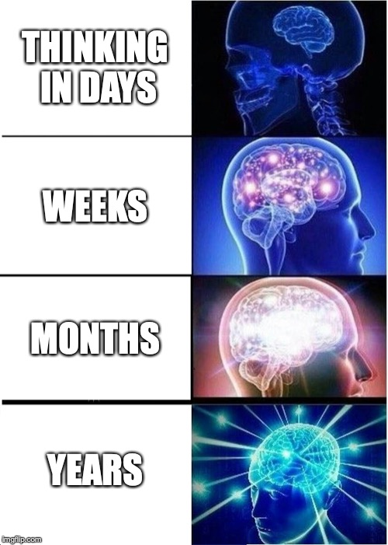
Planning and strategy
Notes:
Planning:
This is not about the ability to use planning tools as much as it is the ability to take large unstructured pieces of work or problems and break them down systematically into smaller manageable pieces that you can make meaningful progress against.
It is about stretching the impact and the boundaries of your work.
When you are a junior IC you think in days, then weeks etc.

Slide 16
Planning and strategy
Think in increasingly larger timelines
Broaden impact
Stretch the boundaries of your autonomy

Slide 17
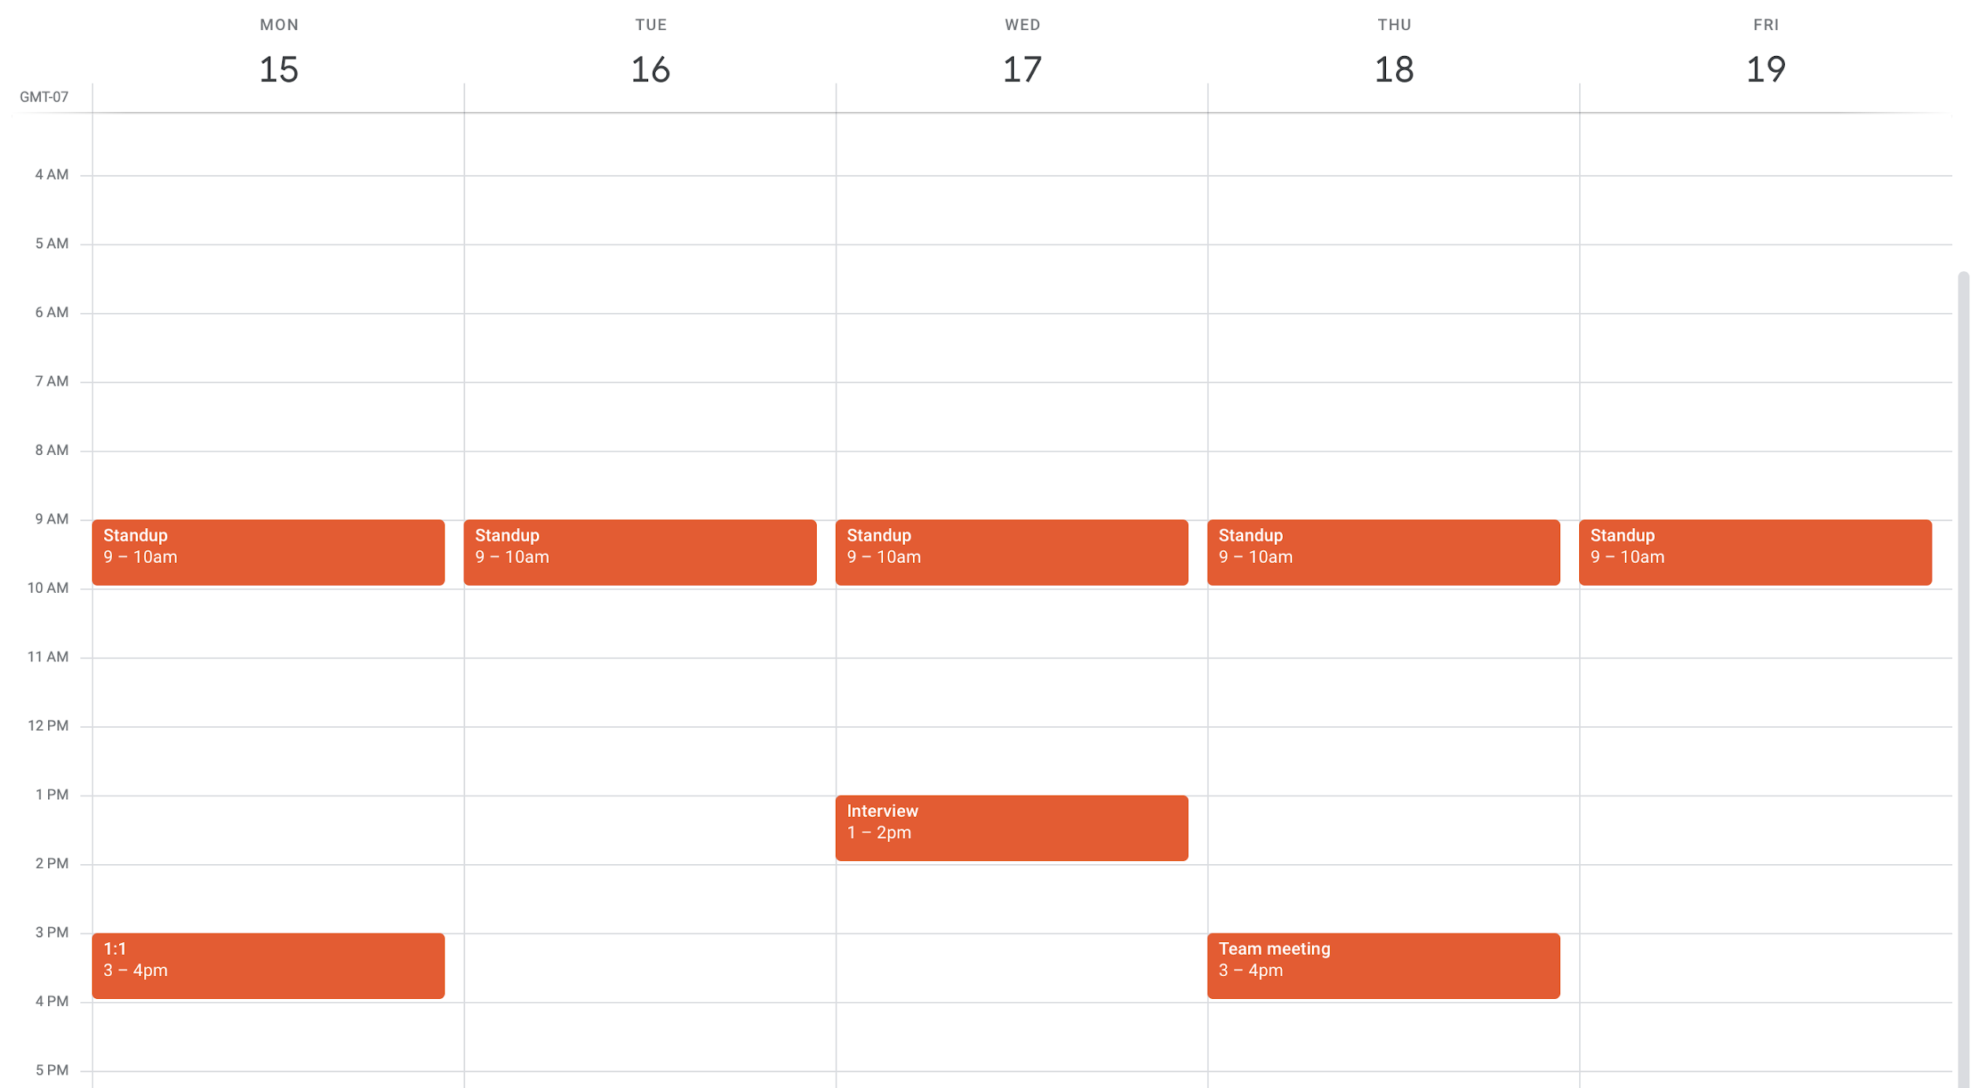
Manage yourself
Notes:
This is your calendar when you start out

Slide 18
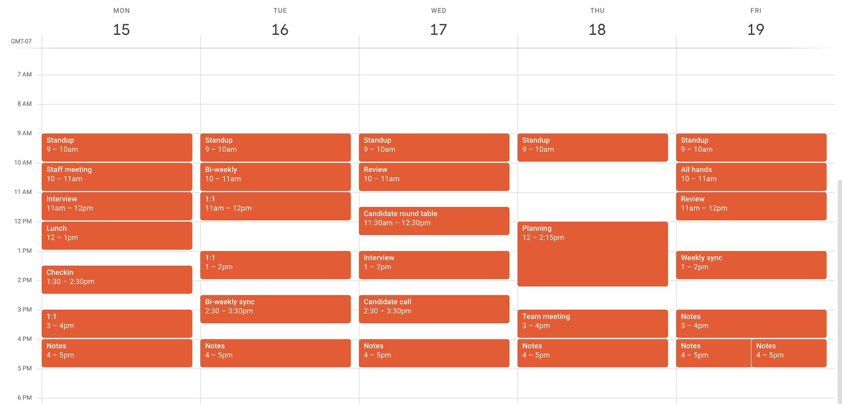
And make time for learning
Notes:
Your calendar when you have been working for a while.
This is true for both ICs and managers.
This is not just a manager calendar.
You need to be intentional and make time in your schedule for learning and working on all of the rest

Slide 19
Core skills
Communication
Empathy
Mentoring and coaching
Planning and strategy
Manage yourself

Slide 20
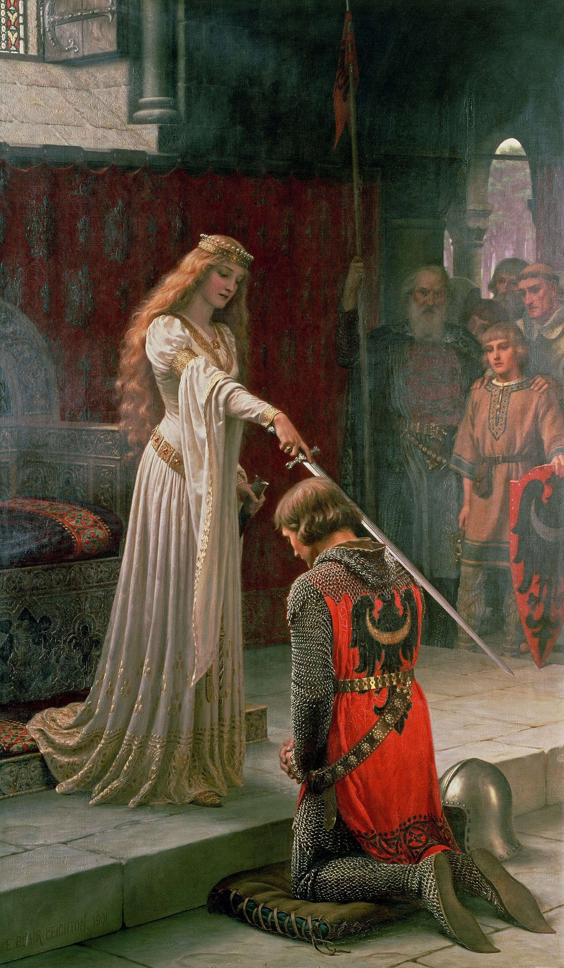
Opportunities and impact over roles
Notes:
It is easy to over focus on the rubric of your current role and the next step in the ladder. However, it’s more useful to think of them as the minimum constraint for opportunities vs the outer bound where you do not have to be “blessed” by a role or title to do the things your would like to be doing longer term.
Regardless of your current role, look for opportunities that exist because of gaps in your organization. These can be both technical or organizational or a mix. Try to solve for those gaps. Prioritize skills and learning over a particular technology.
Do not constrain yourself to the narrow definition of your current role
Look for opportunities to build the skills “you” need

Slide 21
Examples
Engineer curious about management
New manager wanting to grow in the organization
Engineer that wants to remain on the technical track

Slide 22
Career design patterns
Some common career patterns

Slide 23
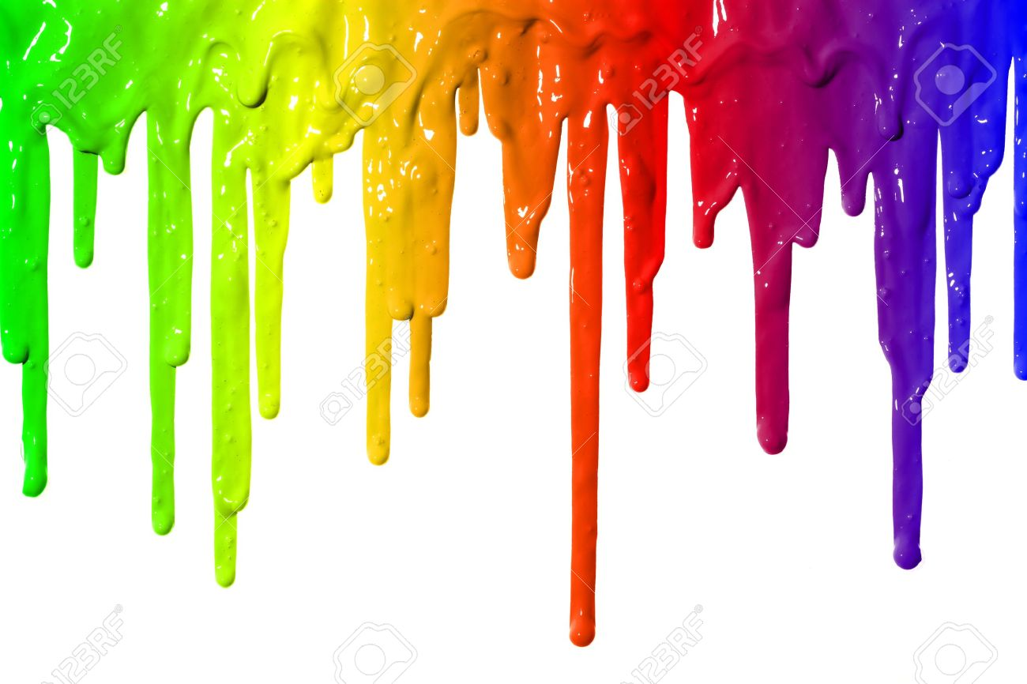
T shaped vs Drip Paint

Slide 24
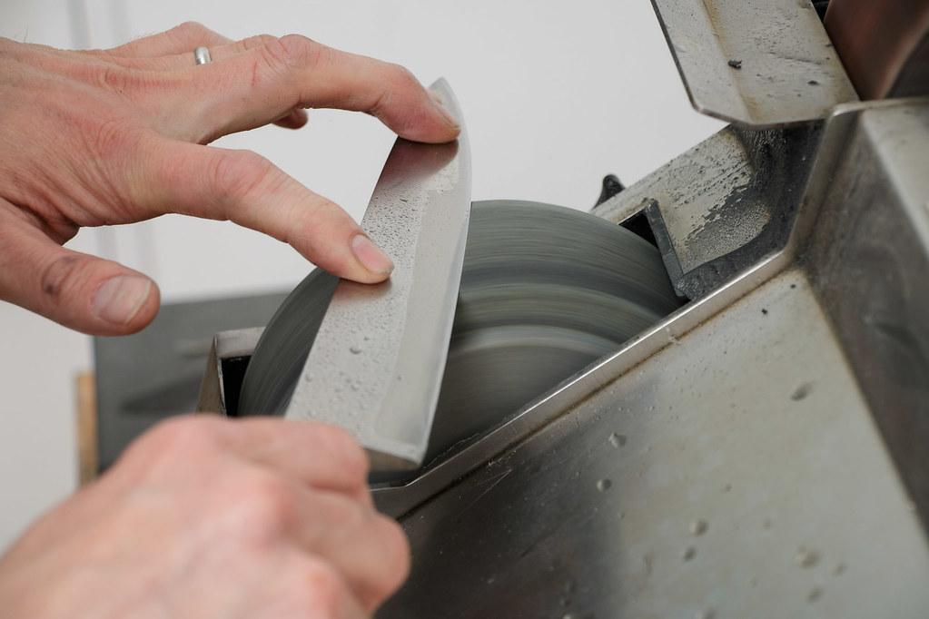
Depth vs Breadth
Notes:
There was a recent twitter thread by Matt Klein of Lyft on this and I’ve linked to it in the slides. But 2 potential ways to think of technical skills is focusing on depth vs breadth and deciding for yourself which kind of path you want to carve out for yourself.

Slide 25
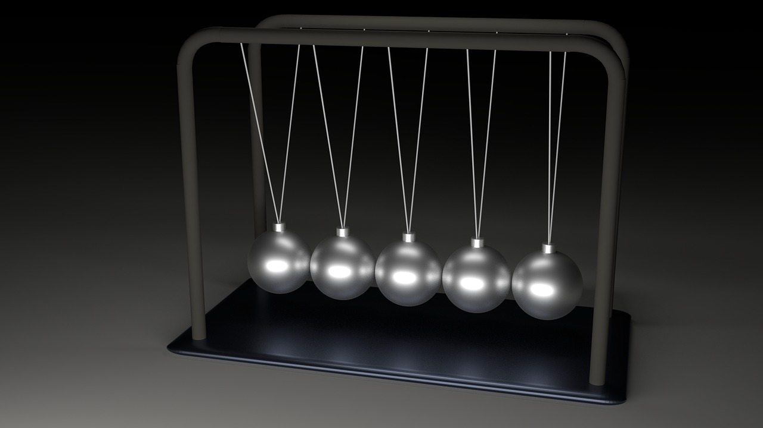
Pendulums
Notes:
You do not have to even stick to a particular ladder.
I have personally supported people that have gone back and forth in these roles.
In your increasingly longer career this will become even more common

Slide 26
Most importantly always improve your technical tool kit
Notes:
These are not the technologies you are working on today
They will most likely not be what you are working on forever
Find out what you are good at and build those out
Distributed systems skills over a programming language

Slide 27
What career design pattern will you invent?

Slide 28
Underrepresented in tech?

Slide 29
Variations in experiences at this stage
Career levels often coincide with life milestones
Caregiving of many kinds
Two body problem - from academia but also seen in tech
These disproportionately impact under represented groups
Women, first generation college graduates, non traditional paths
Increasing lack of representation
Potential increase in impostor syndrome
Notes:
Example from my own experience
Two body problem - from academia but also seen in tech
If you are a manager supporting URMs at this stage you can help!
If you are not an URM and not a manager you can still help.

Slide 30
Seek sponsors and allies
Notes:
Seek sponsors and allies.
Different from mentors

Slide 31
Be a sponsor and ally!
Notes:
This is also where you as a mid to senior person or someone supporting them can be the most effective ally and sponsor. Use your social capital!

Slide 32
Ask for organizational support
Ask for things!
Build your network
Employee Resource Group as advocates

Slide 33
Provide organizational support
Ask for things on behalf of!
Ask for what you can do differently
Make your organization more inclusive
Notes:
If you are supporting people at this stage
Ask for things on behalf of
Ask for what you can do differently
Show up for the URMs in your organization: physical presence and also sponsorship for ERGs and similar communities

Slide 34
Back to ladders & levels

Slide 35
Career ladders & levels
Good engineering organizations need career ladders
Good ones follow these key principles
Notes:
This is a requirement and a lot of the rest of the talk is built on this. If you work in an organization that does not have this really question why and try to change that.
2. Rubrics for the levels within the ladders. A good rubric will capture the expectations of a role for the individuals performing it. They should be detailed enough to capture requirements to progress between levels but should refrain from being a prescriptive checklist.

Slide 36
Differentiated by function
Software Engineering ICs, Engineering Managers, Product Managers etc
Management is not a promotion
Expectations for roles are clear with multiple parallel ladders
Captures the value of a particular role
Notes:
Ladders separated by function i.e. at a minimum separate ladders for individual contributors and managers.
As organizations mature you typically start seeing more parallel ladders being added into the mix e.g. Product Management, Program Management etc. but you need to start with at least a clear separation between those 2 roles.

Slide 37
Rubrics for levels
Expectations of individuals in a role at a particular role
Detailed enough to capture progression
Refrain from being a prescriptive checklist
Notes:
A good rubric will capture the expectations of a role for the individuals performing it. They should be detailed enough to capture requirements to progress between levels but should refrain from being a prescriptive checklist.

Slide 38
Recognize and reward organization’s values
Notes:
Does your organization’s ladder reflect its values?
Is the right work recognized and reflected in progression
Is *all* work recognized? Is glue work recognized? Community building? Interviewing?
Example? Something I value very much about my current role is that my manager is very explicit about recognizing and rewarding community building and in particular inclusion work. This is something that actually gets cited in my performance review. It is also an explicit part of the career ladder.

Slide 39
How do you evaluate an organization for these?

Slide 40
Evaluating organizational support
Career ladders and rubrics
Support and recognize core skills
Support opportunities and impact over roles
Support under-represented minorities
Value career development
Notes:
This slide actually comes from a scenario when I was doing an interview chat with a candidate.
We had already made them an offer and were at the “sell” stage.
They are senior person and a couple of the questions they asked me were:
How does your organization support senior ICs?
As I answered this and other questions I came up with this framework to evaluate a “organizational support”
Think of each of these as a question to ask yourself and then to reframe for your broader organization.

Slide 41
Career plan
Notes:
Now let’s talk about everything we discussed so far and come up with some actionable steps to take.

Slide 42
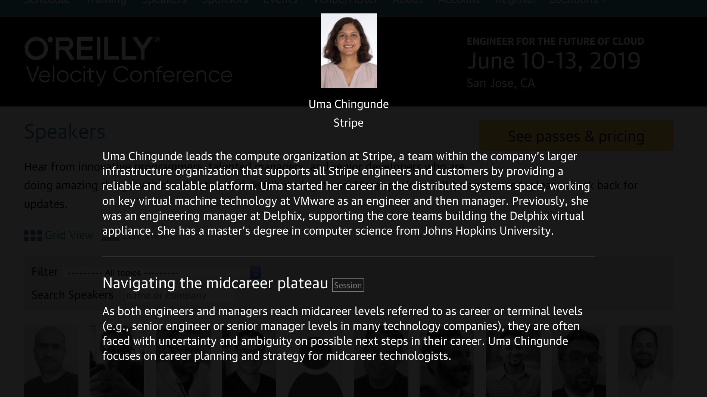
Future speaker bio?

Slide 43
Brag document
From Julia Evans’s template
A "brag document" or "accomplishments document" is a summary of what you've accomplished in last 6 months/year & what the impact of your work in that time was.
Notes:
Writing down your accomplishments is awesome and useful because:
your manager can reference it when they're explaining why you should be promoted / deciding on your performance designation. This is especially useful when you have a new manager who isn't familiar with your past work.
it's a good tool to take charge of your own career & growth
it helps remind you how far you've come
knowing what you've done in the past helps you recognize your strengths & figure out where you want to improve in the future. It's easier to see patterns when you write everything down.

Slide 44
What sparks joy?

Slide 45
Iterate
Short term goals
Tie to business needs
Share with your manager, sponsor or mentor
Ask for support
Execute
Notes:
Examples of my personal goals for 2019
Improve my writing
Speaking at a conference
Get help with these goals
Thank you for being my first ever large conf audience

Slide 47
References and additional reading
https://speakerdeck.com/polotek/creating-a-career-ladder-for-engineers
The pendulum between IC and management - Charity Majors
Career narratives and roles over rocketships- Will Larson
https://threadreaderapp.com/thread/1130206773078421504.html
https://twitter.com/clare_liguori/status/1126992938502742016
https://www.kitchensoap.com/2012/10/25/on-being-a-senior-engineer/
https://www.facebook.com/notes/kent-beck/paint-drip-people/1226700000696195/

